Slide 1

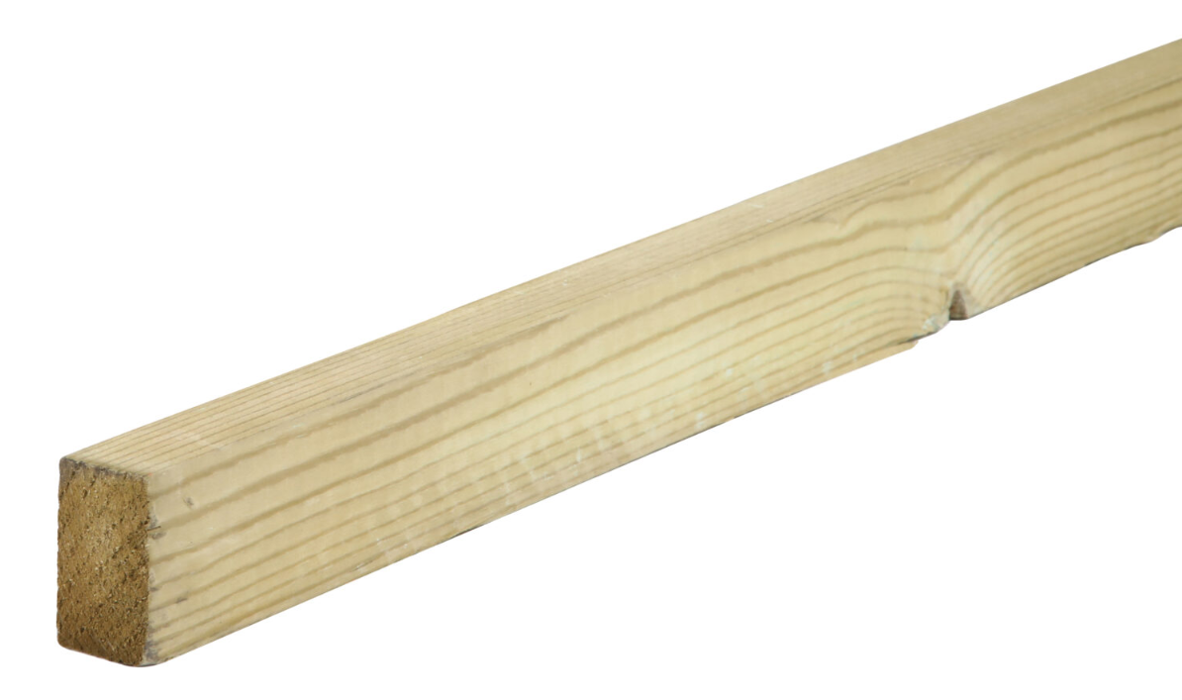

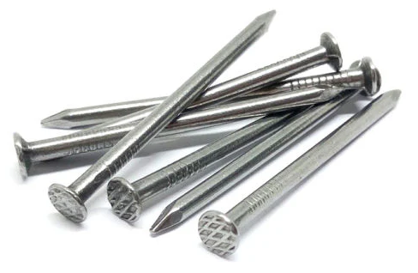
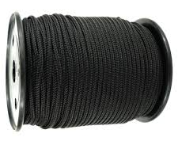
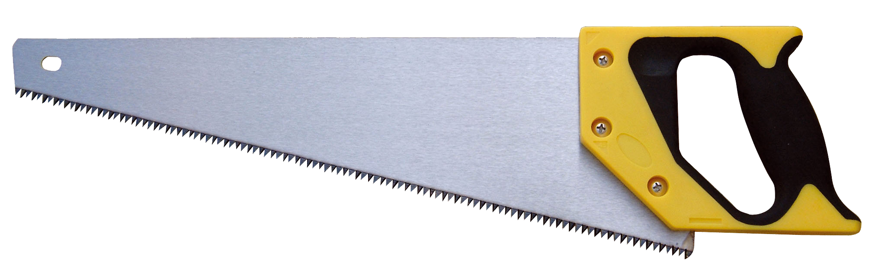
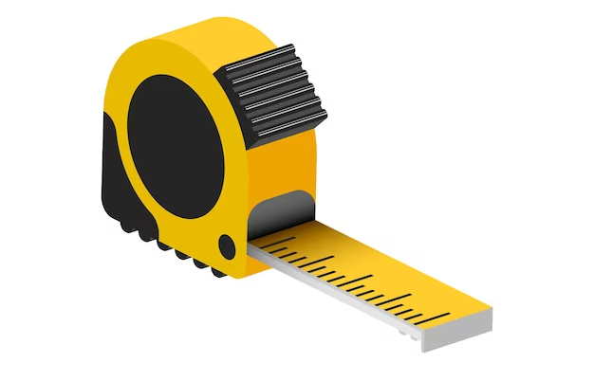
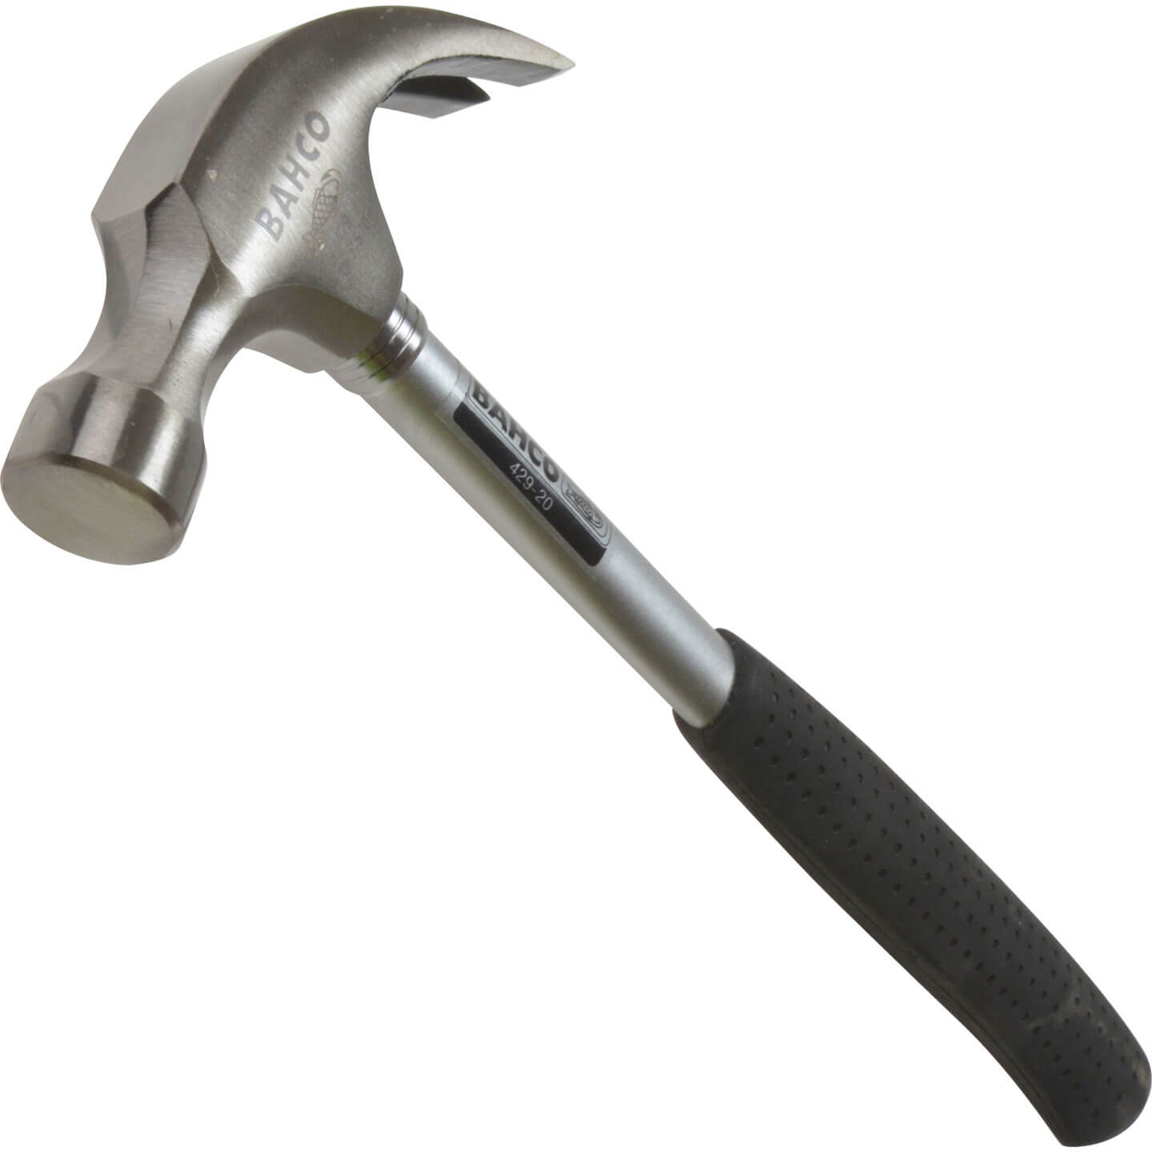
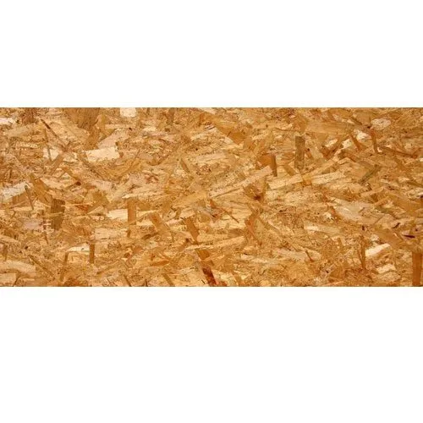
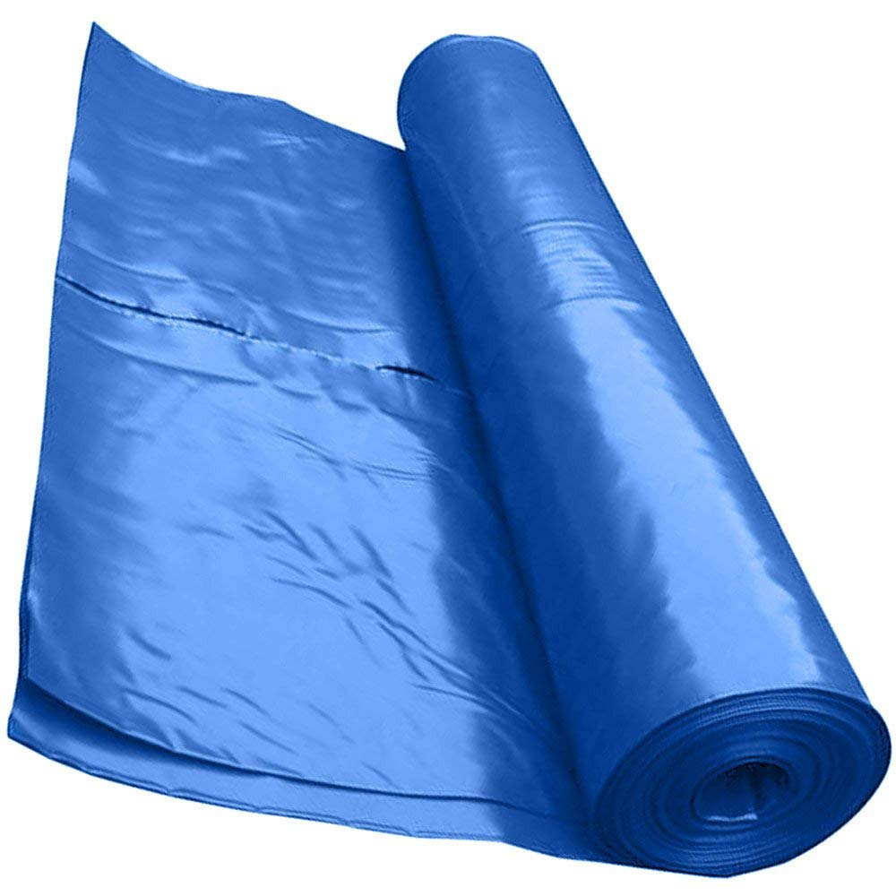




Emergency Shelter Kit
This IEC indicates techniques to assemble a shelter and does not prescribe a specific shelter design. Partners are encouraged to modify the quantities below based on the materials, resources, and space available to them.
For a video demonstration, refer to the ESK: Shelter Kit Construction Video | Shelter Cluster
Essential Components
Component | Unit | Quantity | Indicative Picture
Timber, untreated, essential for frame construction, required to be at least 2.4 meters in length. This IEC is for cross-sections of 5cm x 2.5cm | Pcs | 114
Tarpaulins, woven plastic, available in sizes of 6x4 meters, 5x4 meters, or as a roll of 4 meters width. They can be used for roofing, walls and flooring. | Pcs | 3
Nails, 5 cm nails for timber connections. Used for structural joints and fixing cover-battens. | Kg | 1.6
Rope, Minimum 30 meters length, in roll, 6mm thickness. | Lm | 30
Hand saw, total length 60 cm, for wood, good quality, tempered, hardened and set teeth. Unbreakable handle. | Pcs | 2-3
Measuring tape, 3 meters, graduated in centimeters. | Pcs | 1
Hammer, metal or fiberglass handle. | Pcs | 1
Optional Components
Timber sheet (Plywood or OSB), Approx. 1 cm thick, used for creating beams, trusses, doors, bracing, raised floors, and internal cladding. | Pcs | 3
Plastic sheet, 0.3mm thick, roll is up to 50 sqm per shelter. Minimum width 4 m. | Sqm | 50
This IEC has been developed by

Slide 2
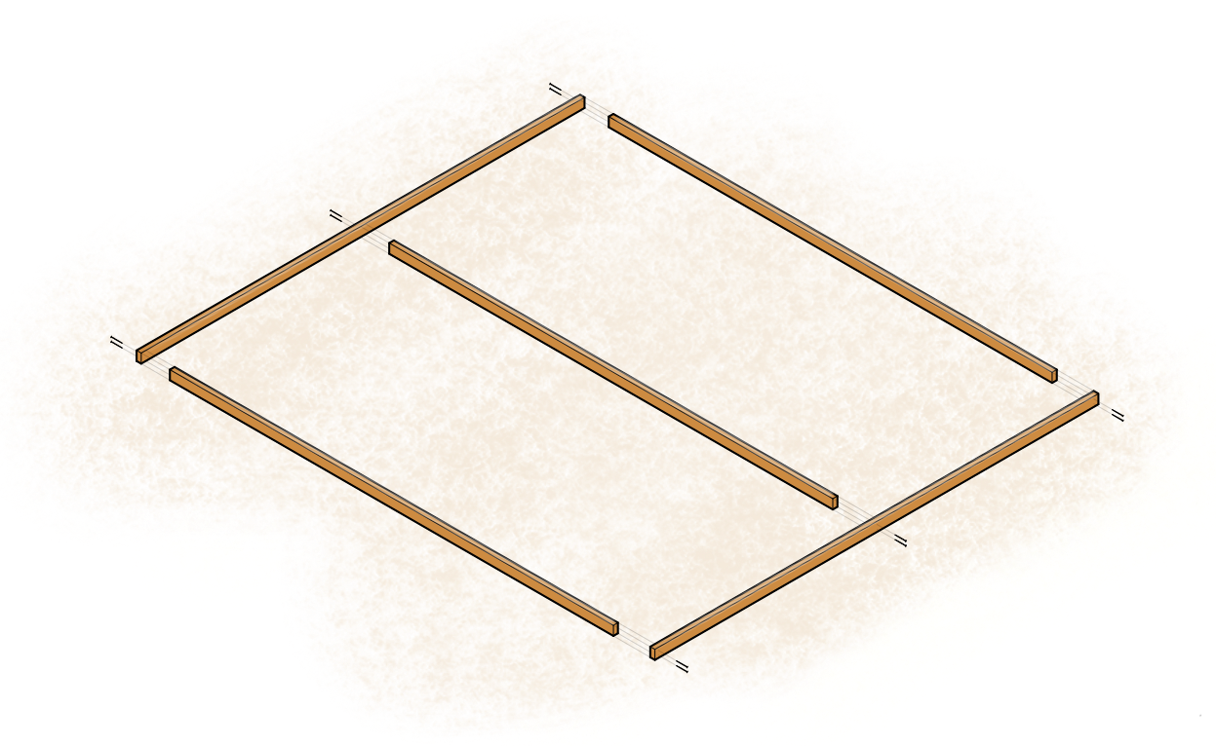
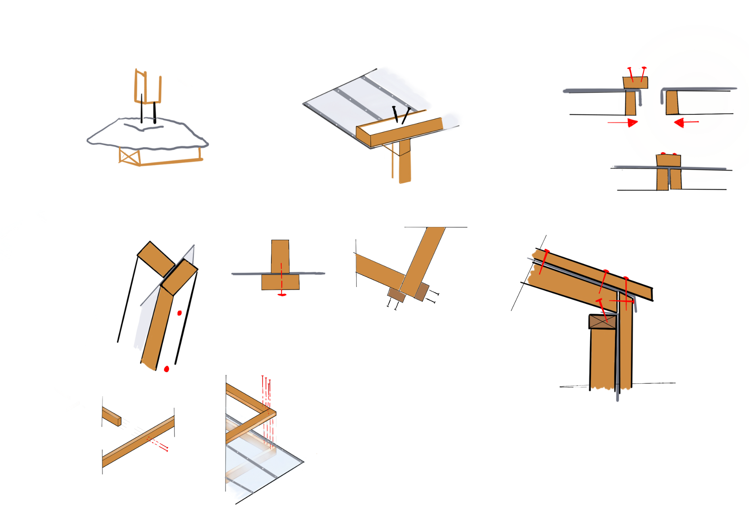

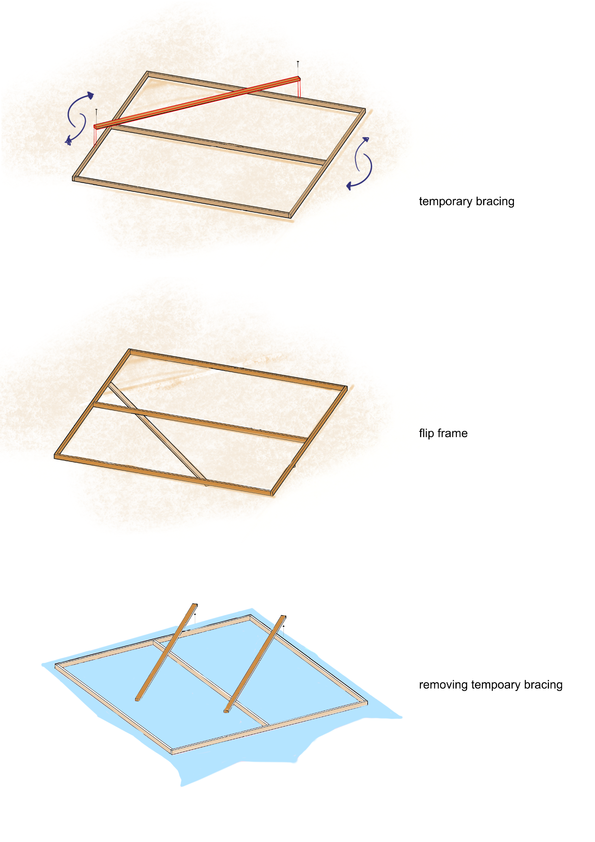

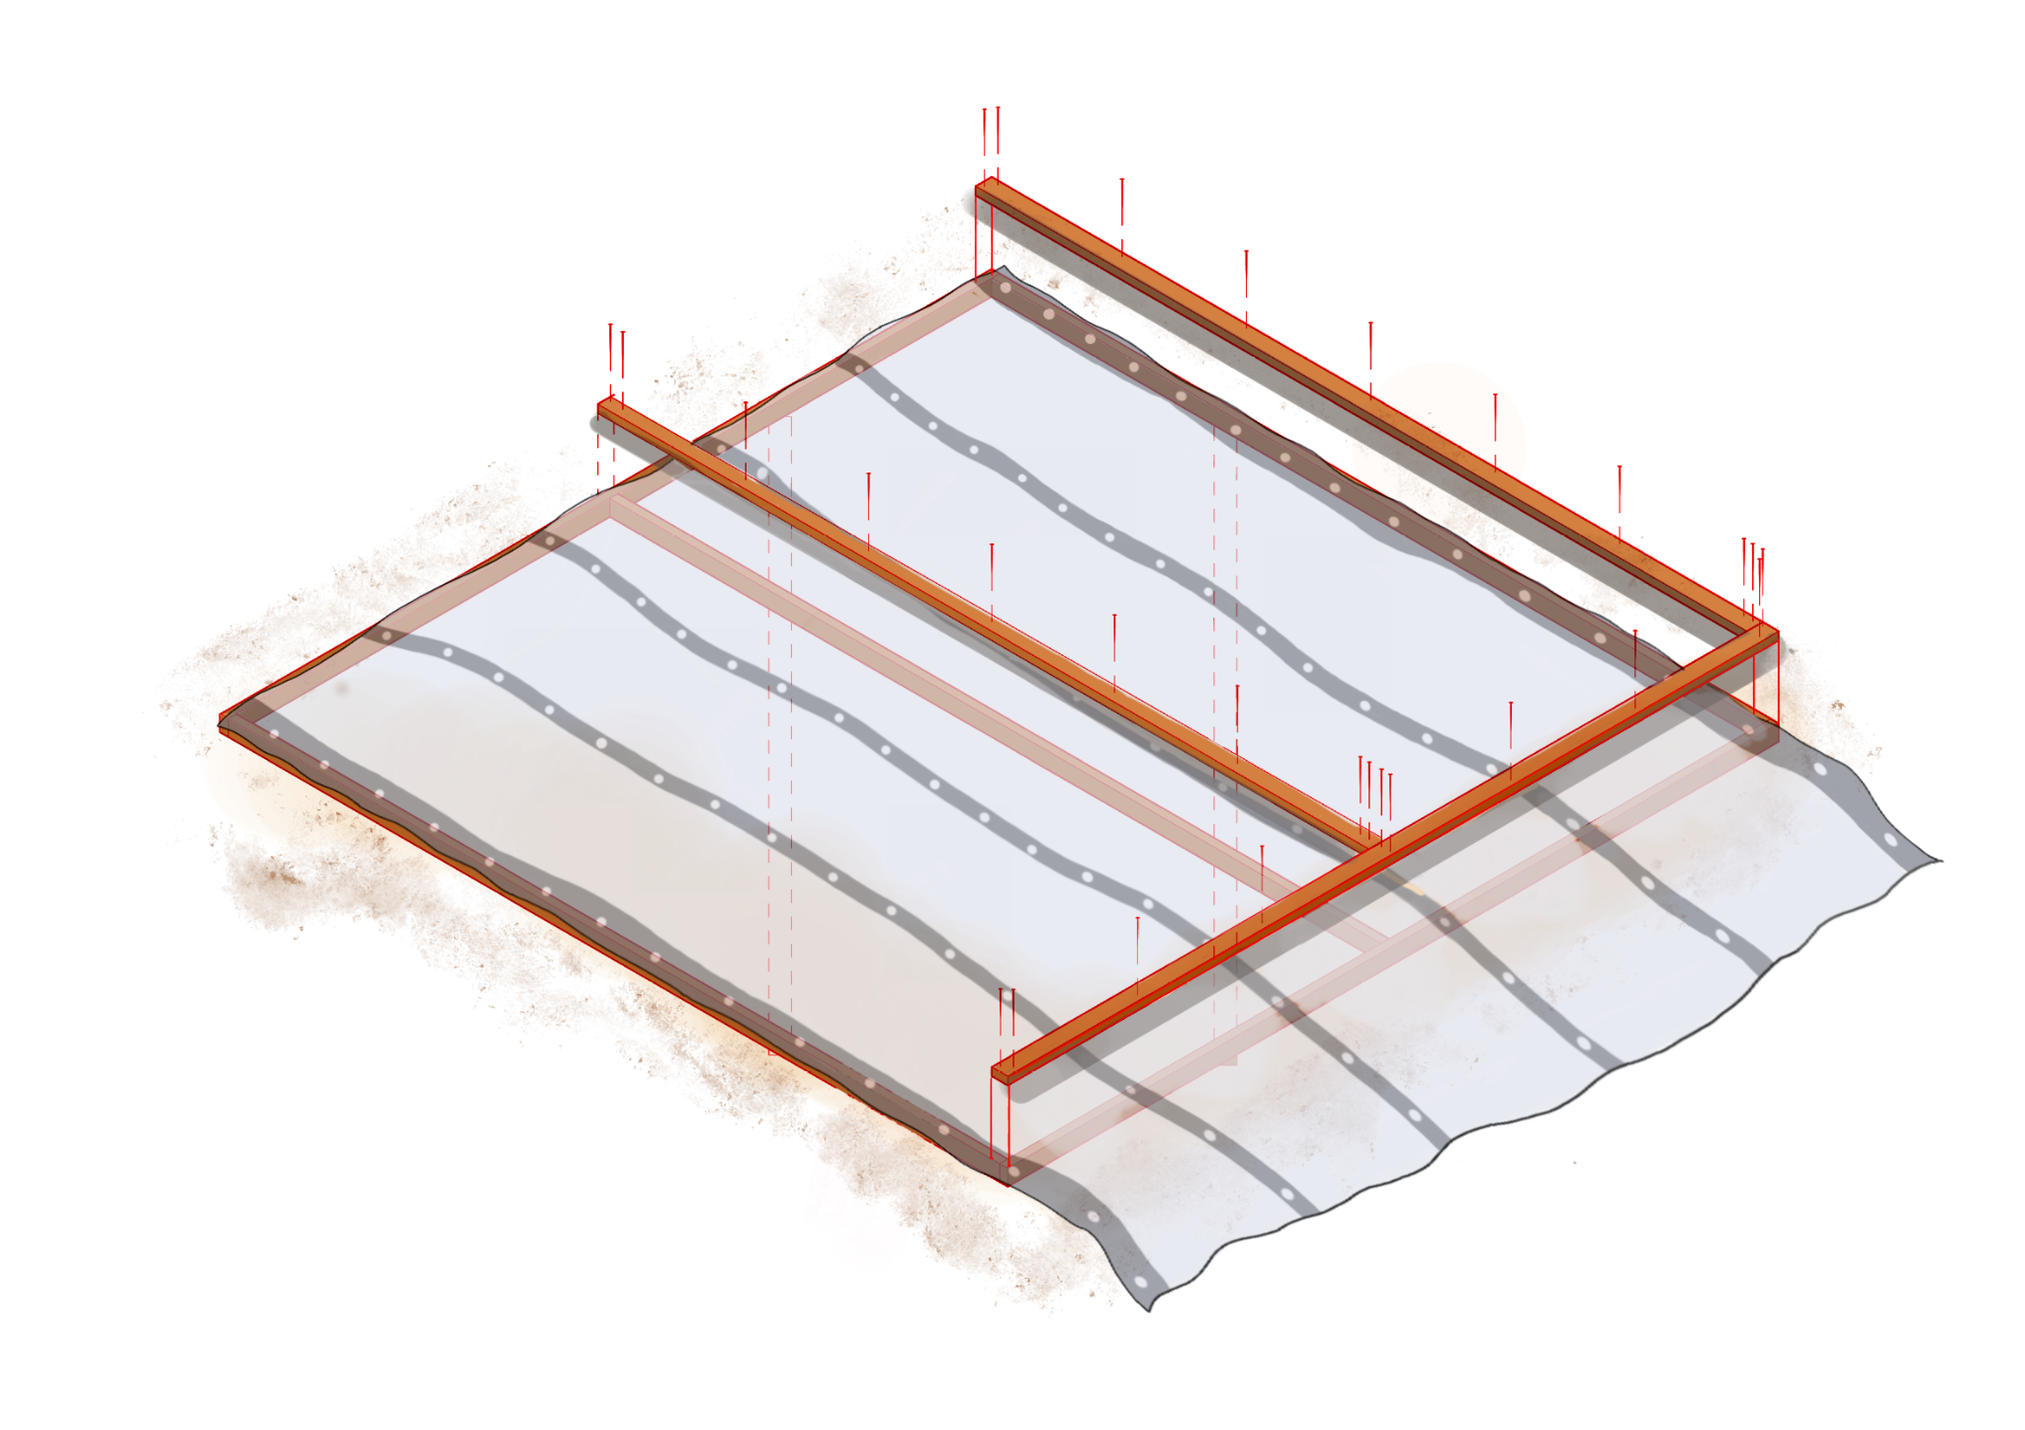
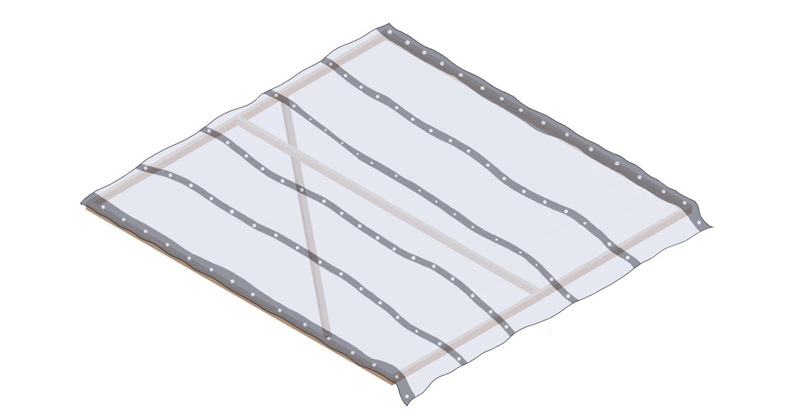
How to Build Wall Panels
a= 2.4 m
Thin edge = 2.5cm
a=2.4 m
a
5cm nails
a
a
1. Lay out the pieces of timber, standing them up on the thin edge.
2. Nail the timber together using 5cm nails.
Temporary bracing
//
Flip it
//
//
//
To check if the panel is square: measure the two diagonal measurements, should be equal.
3. Add temporary bracing, of any size, to hold it square then flip it to fix the tarpaulin on the frame.
Fix Tarpaulin
5cm nails
30 cm
60 cm
4. Lay the tarpaulin over the frame. Leaving a 60cm outside the bottom edge of the frame, to avoid filtration and to favor the anchorage.
5. Fix on the 5 x 2.5cm cover battens with
5 cm nails every 30cm.
The frame is constructed as a T-section which makes it strong
The tarpaulin holds the frame square and so should be pulled tight, but not so tight that it bends the timber.
Tarpaulin fixed
= Panel held square
= Remove temporary bracing
2.5cm
Pull tarpaulin tight
5cm
2.5cm
This IEC has been developed by

Slide 3
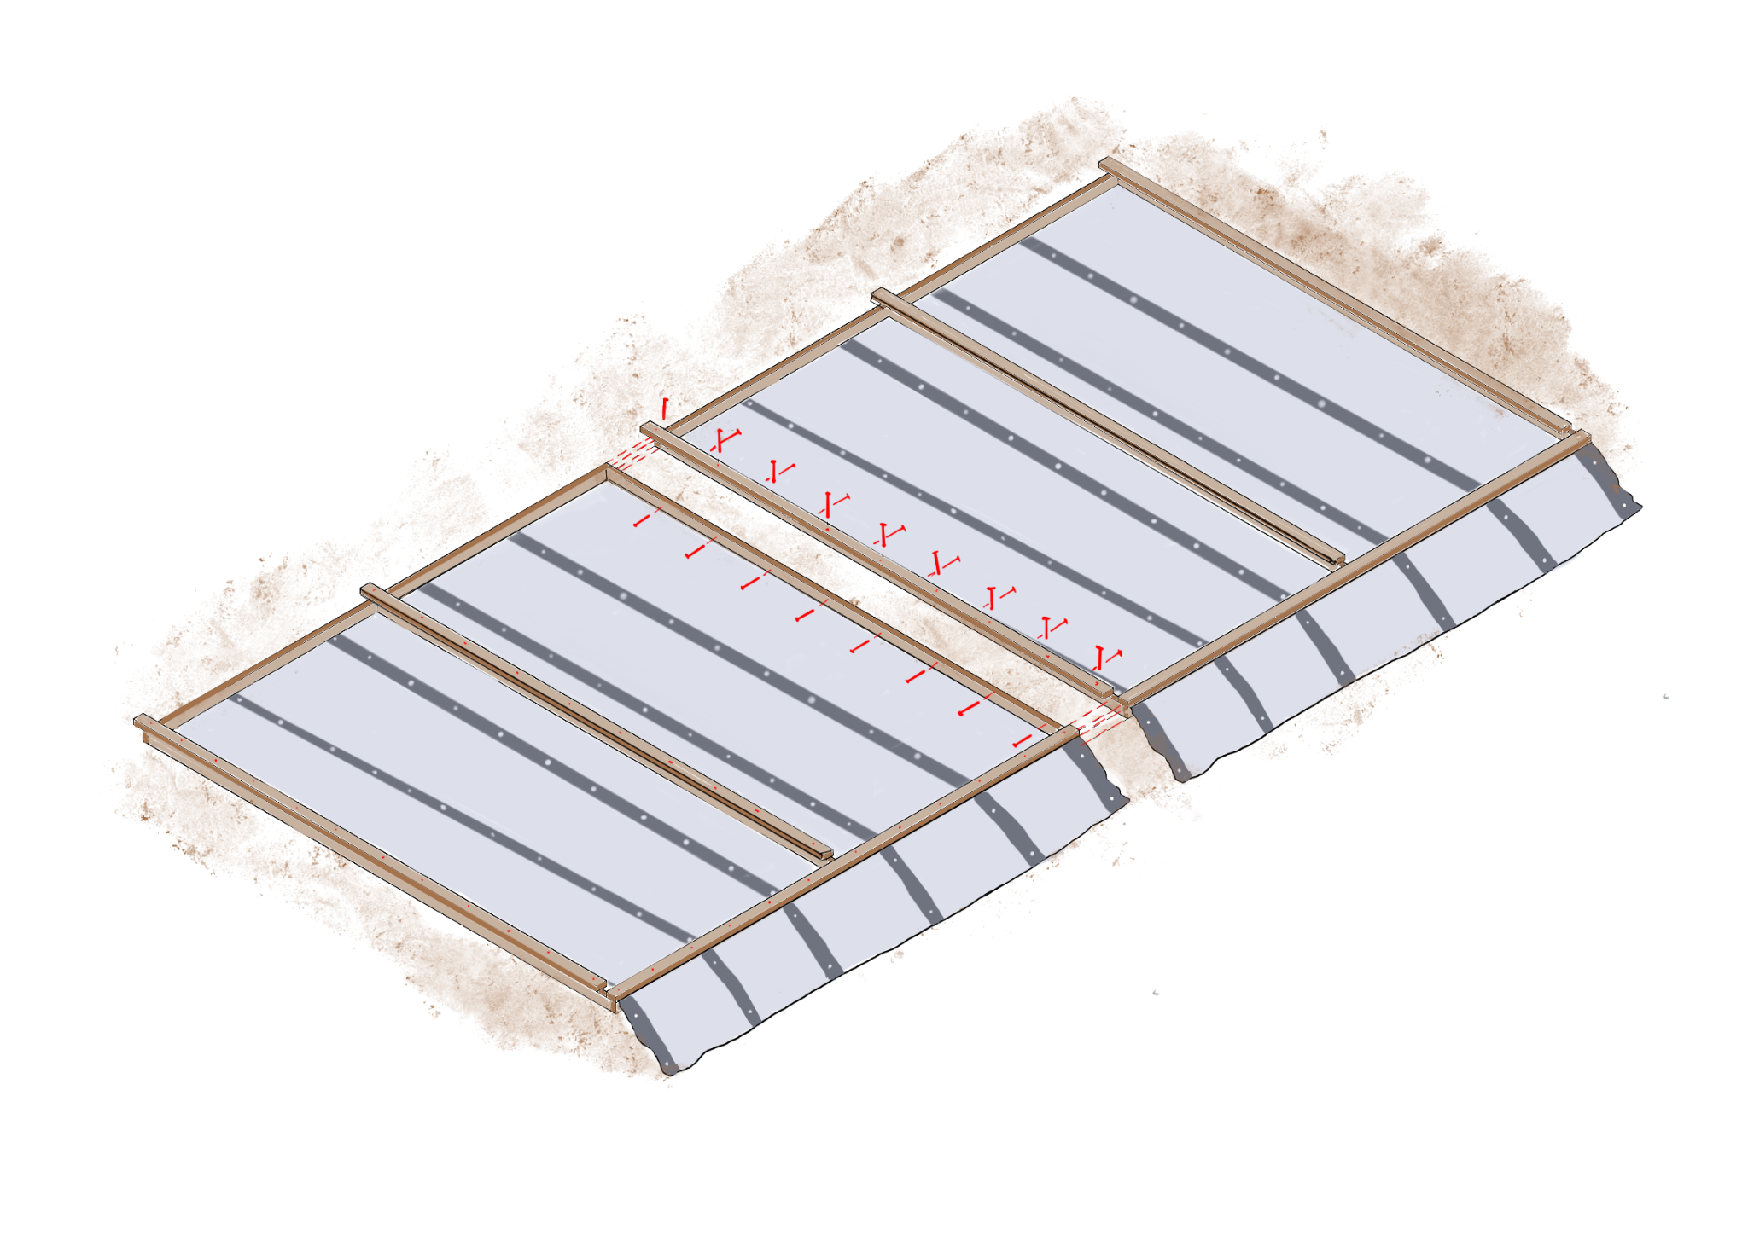
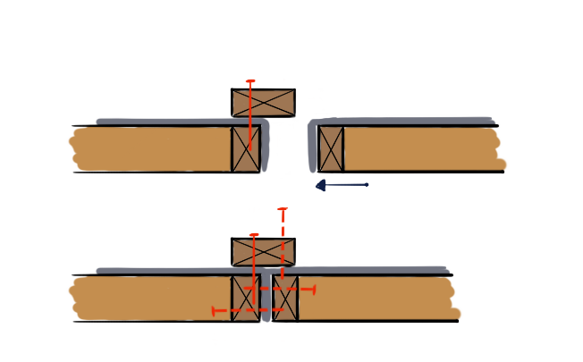
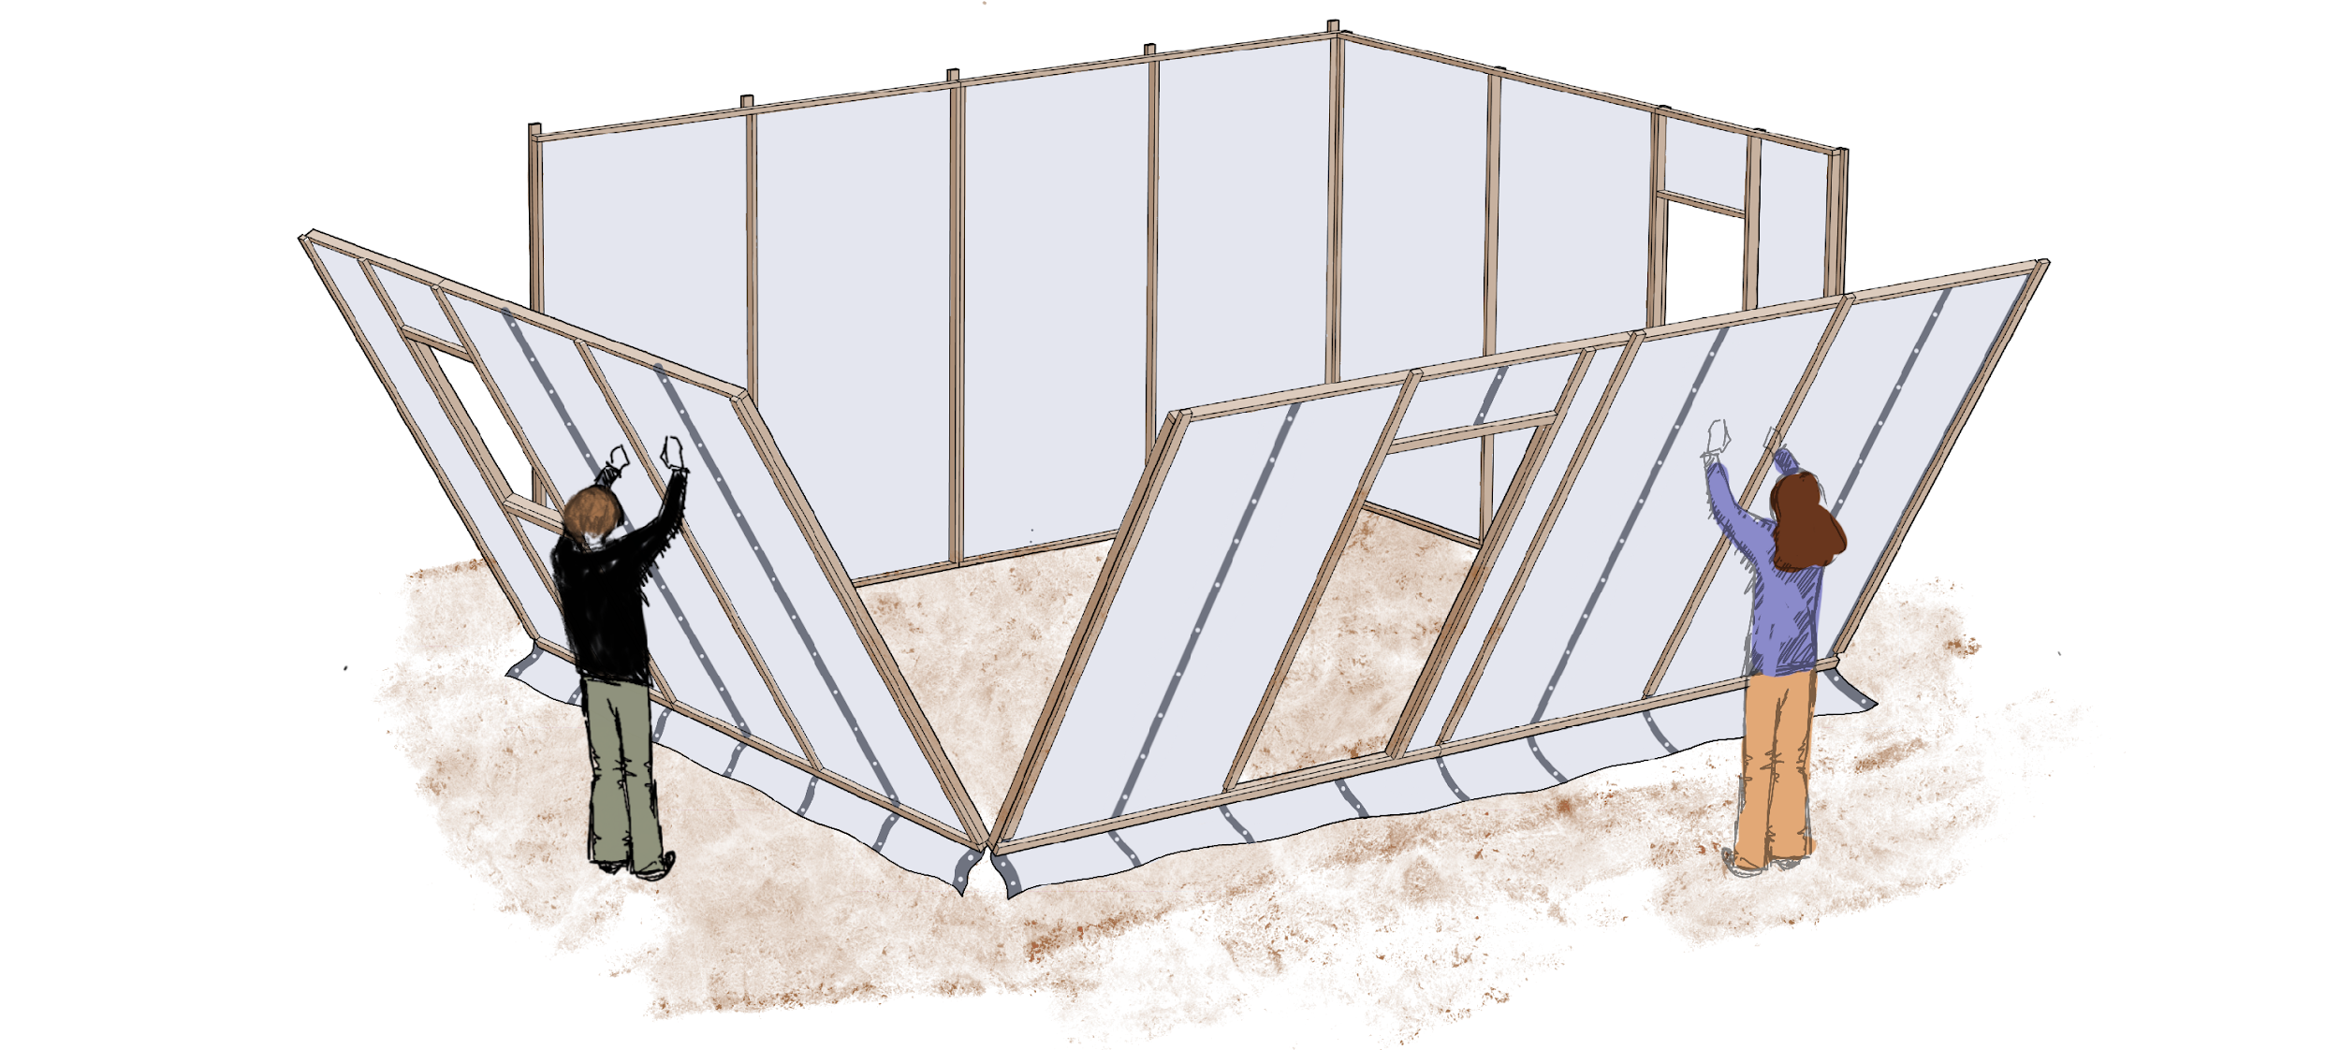
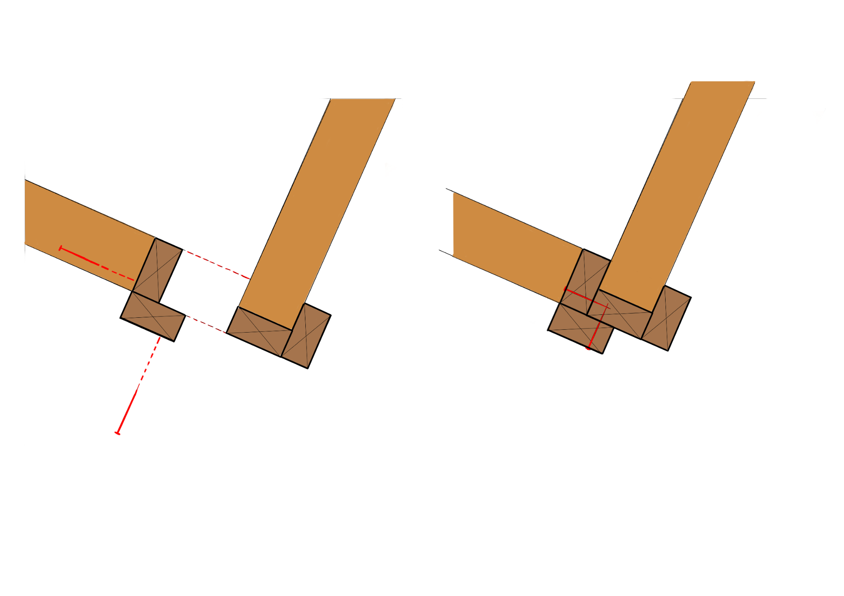
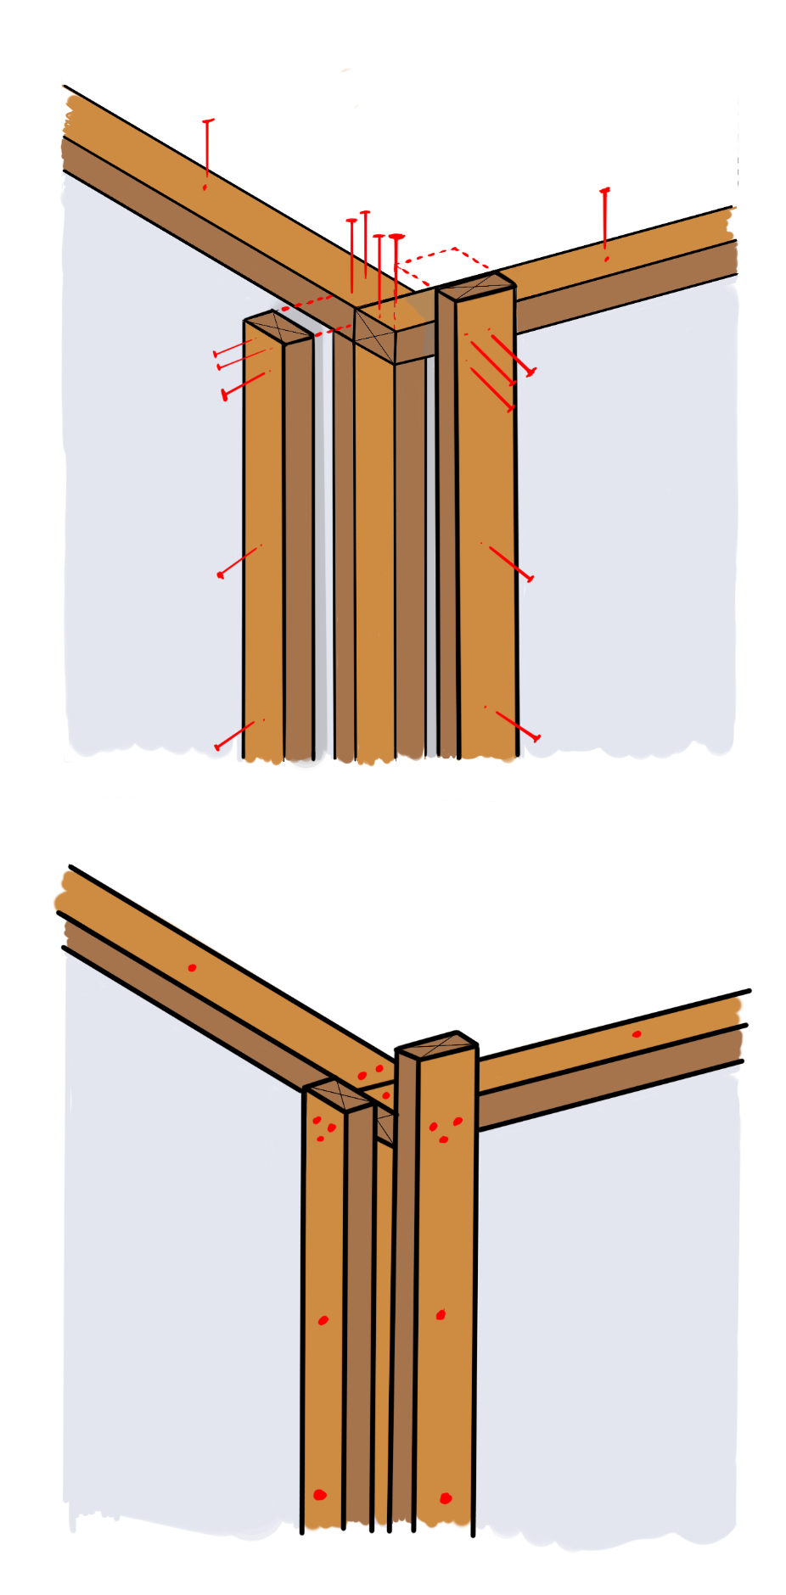
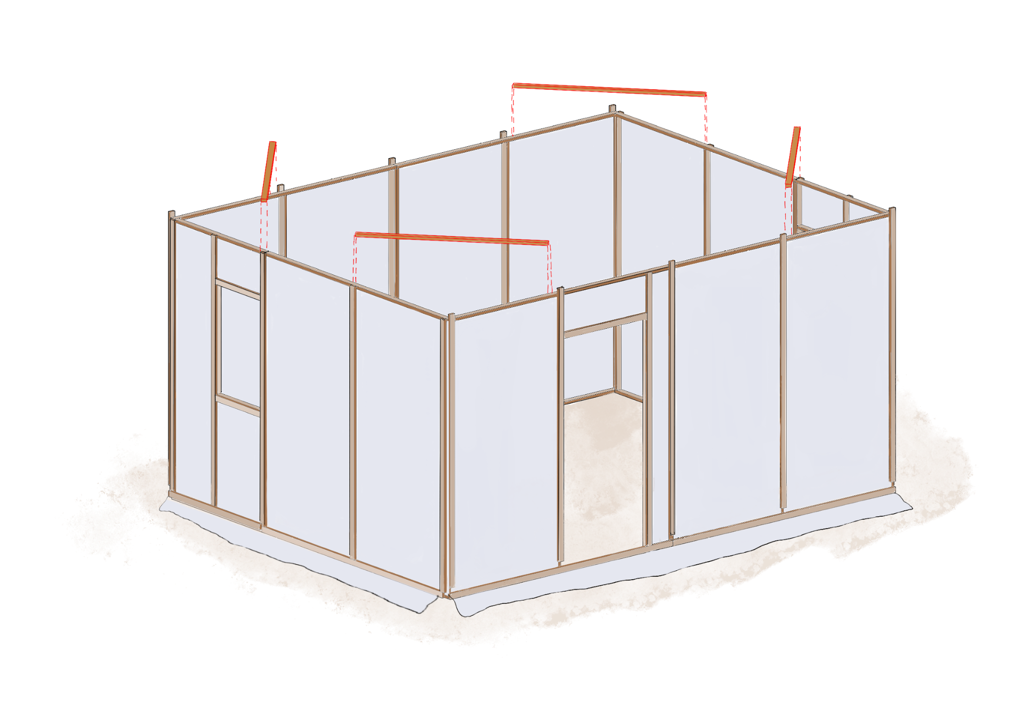
How to Connect Wall Panels
Panel 1 cover-batten
5cm nail
Panel 1
Tarpaulin
Panel 2
Panel 1
Panel 2
5cm nails
A. Move Panel 2 closer to Panel 1
Panel 1 cover-
batten
B. Connect the panels together by nailing the cover-batten
Skirting = 60cm
C. Nail the vertical studs timbers once the panels are lifted
The panels are connected together while still flat on the ground. The cover-batten is used to make a strong connection. Once the wall panel has been lifted into position, then the two vertical studs must also be nailed together.
Lift the panels together
How the corner is joined together?
Plan view
Connect the corners securely using:
Is the shelter square? Measure the diagonals, should be the same.
5cm nails
Add corner bracing
30 cm
Skirting = 60cm
This IEC has been developed by

Slide 4
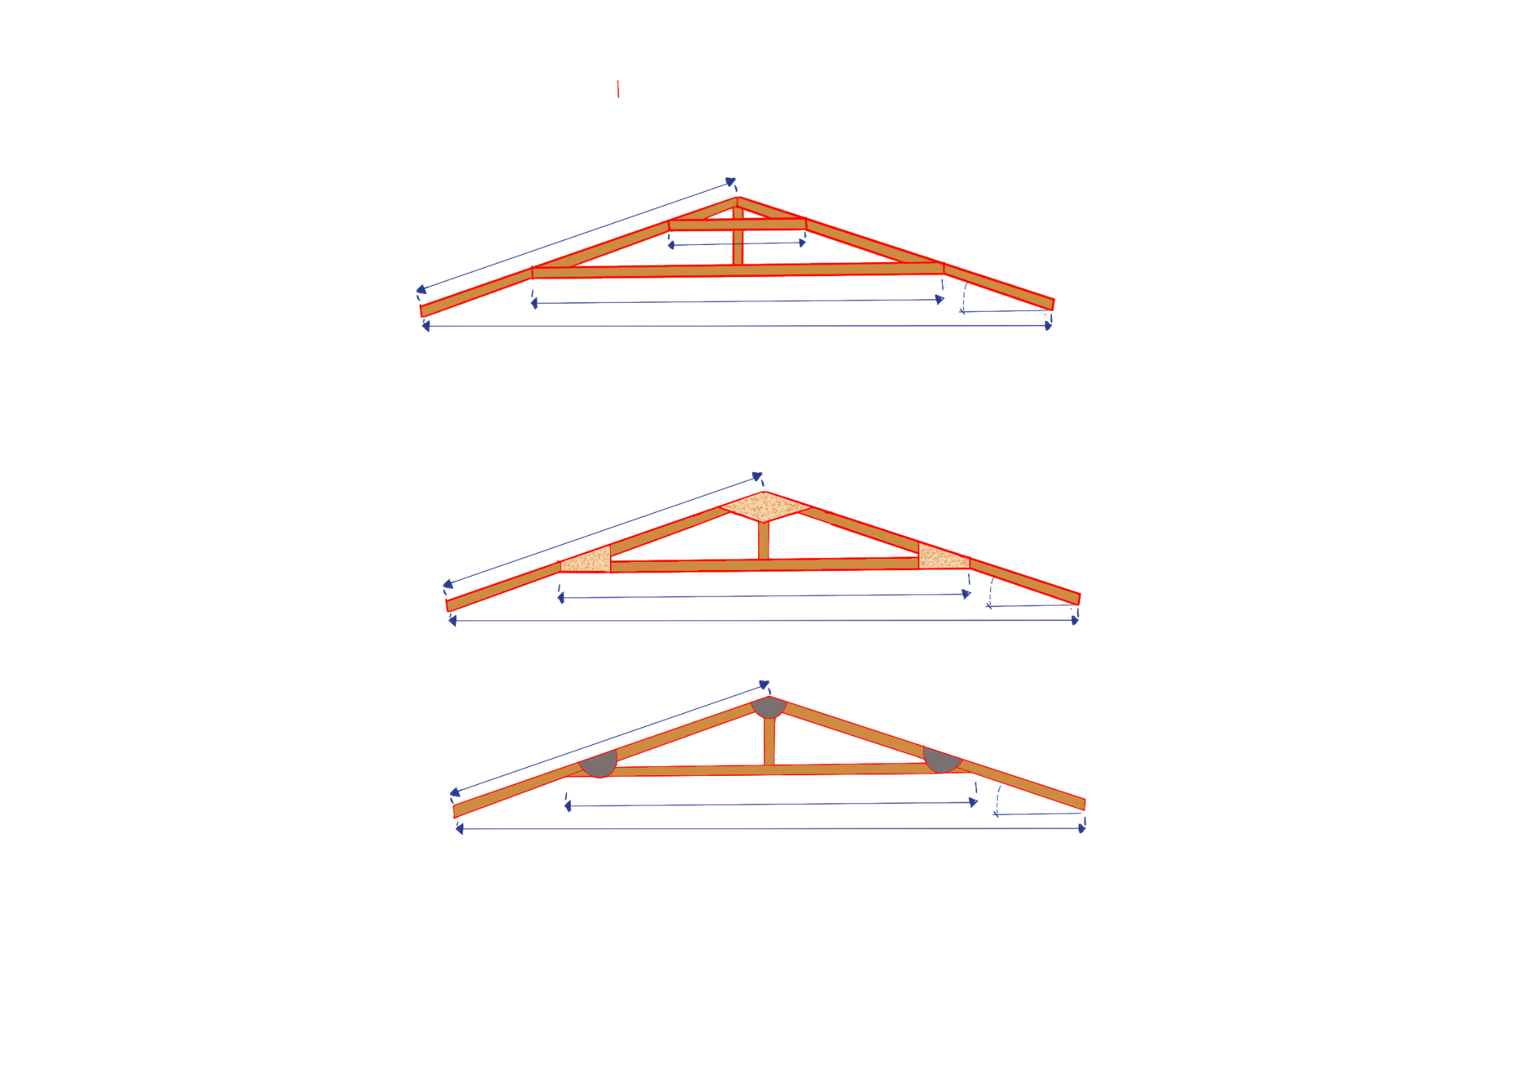
Roofing: Pitched Roof
1.928 m
7.87 m
2.4m
15°
3.7m
The horizontal pieces of timber are doubled, one on either side.
1.928 m
2.4m
15°
3.7m
If OSB or plywood is available, then this truss with ‘gusset plates’ is a good option with strong connections.
1.928 m
2.4 m
15°
3.7m
If short of timber, this is a good option. Strong connections are made with pieces of used tin cans.
HELPFUL
TIP
To ensure uniformity and save time, construct all trusses simultaneously by stacking them one on top of the other or using one as a template.
This approach guarantees that each truss is identical and reduces the risk of errors during the assembly process.
This IEC has been developed by

Slide 5
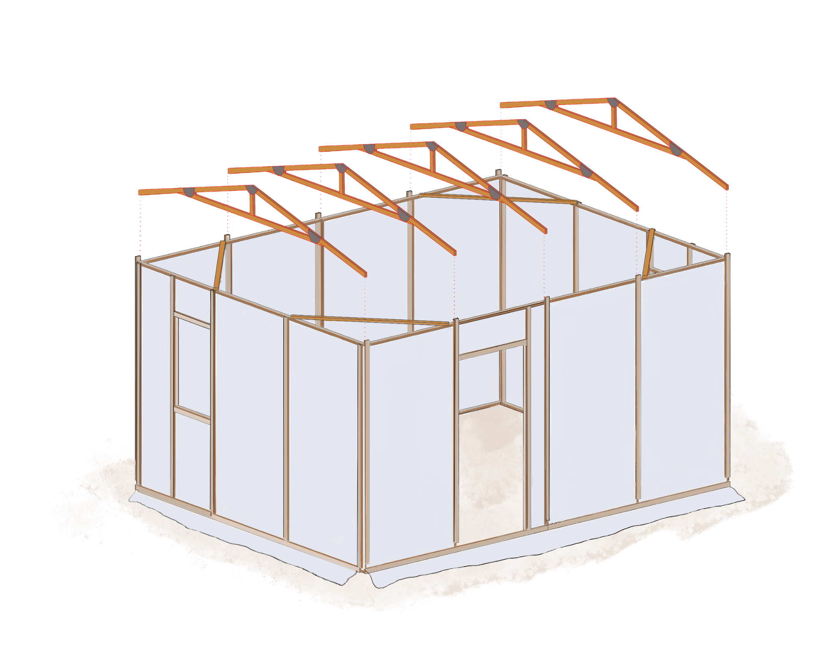
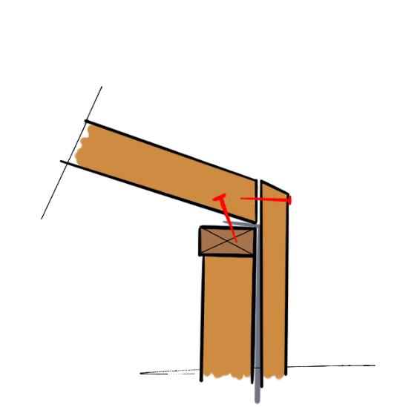
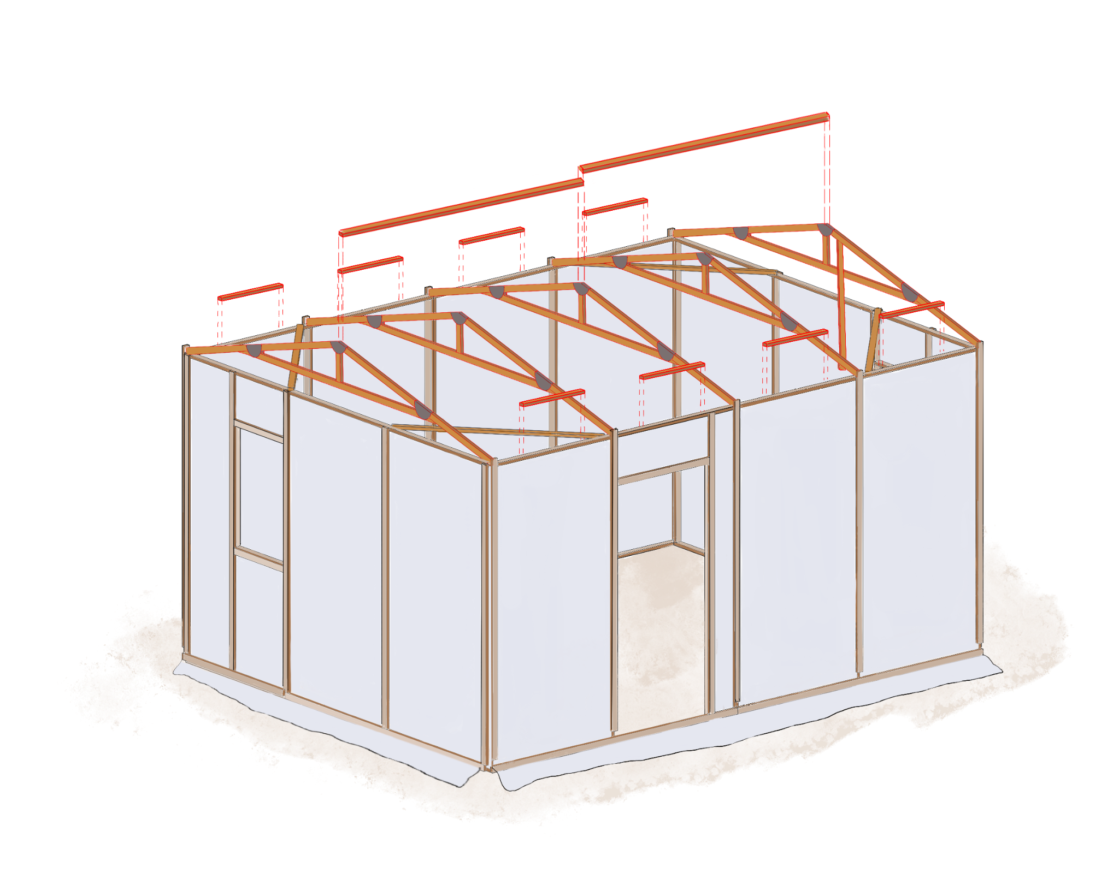
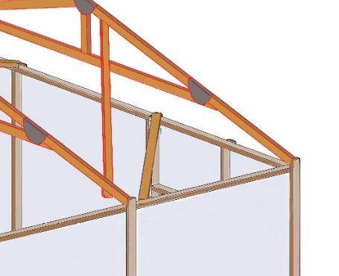
How to Build Roof Trusses
The trusses are placed one by one and fixed to the wall plate
5cm nails
Truss
Tarp
Wall plate
Wall panel
Cover batten
2.4m
The short off-cuts and cover battens are there to secure the top of the tarpaulin.
2.4m
Diagonal bracing
The long horizontal piece at the ridge of the roof should be 2 x 2.4m lengths. They join the trusses together and also provide a support for the tarpaulin.
Diagonal braces need to be fixed, one at either end. These are fixed to the underside of the first and second truss and the final two trusses.
This IEC has been developed by

Slide 6
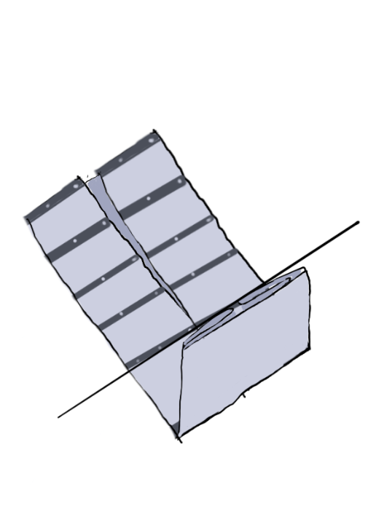
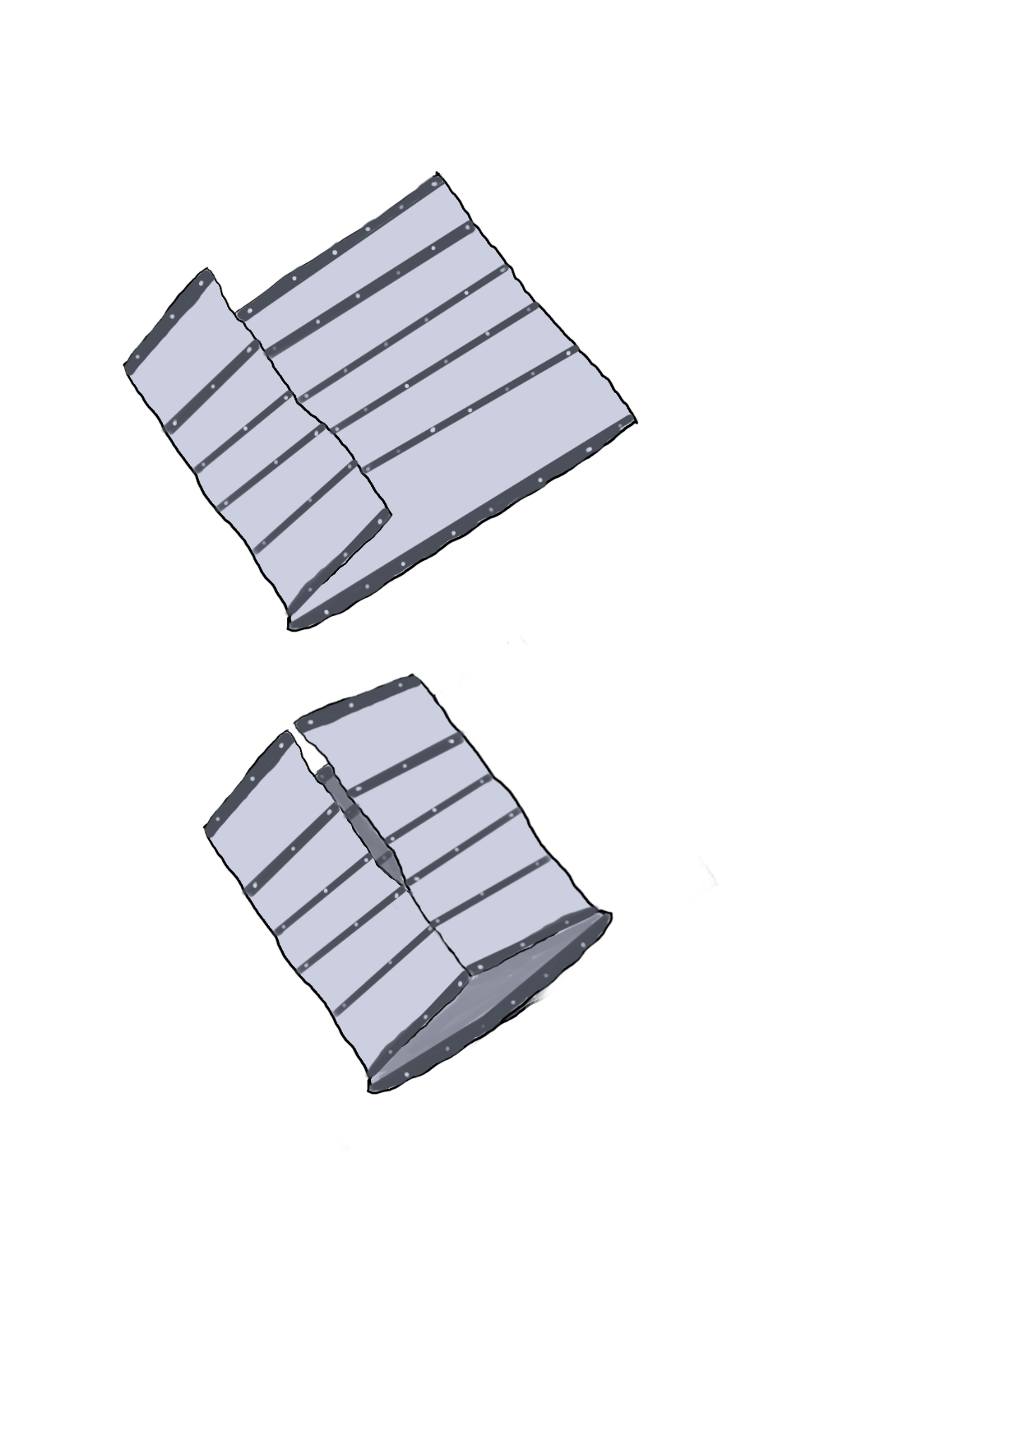
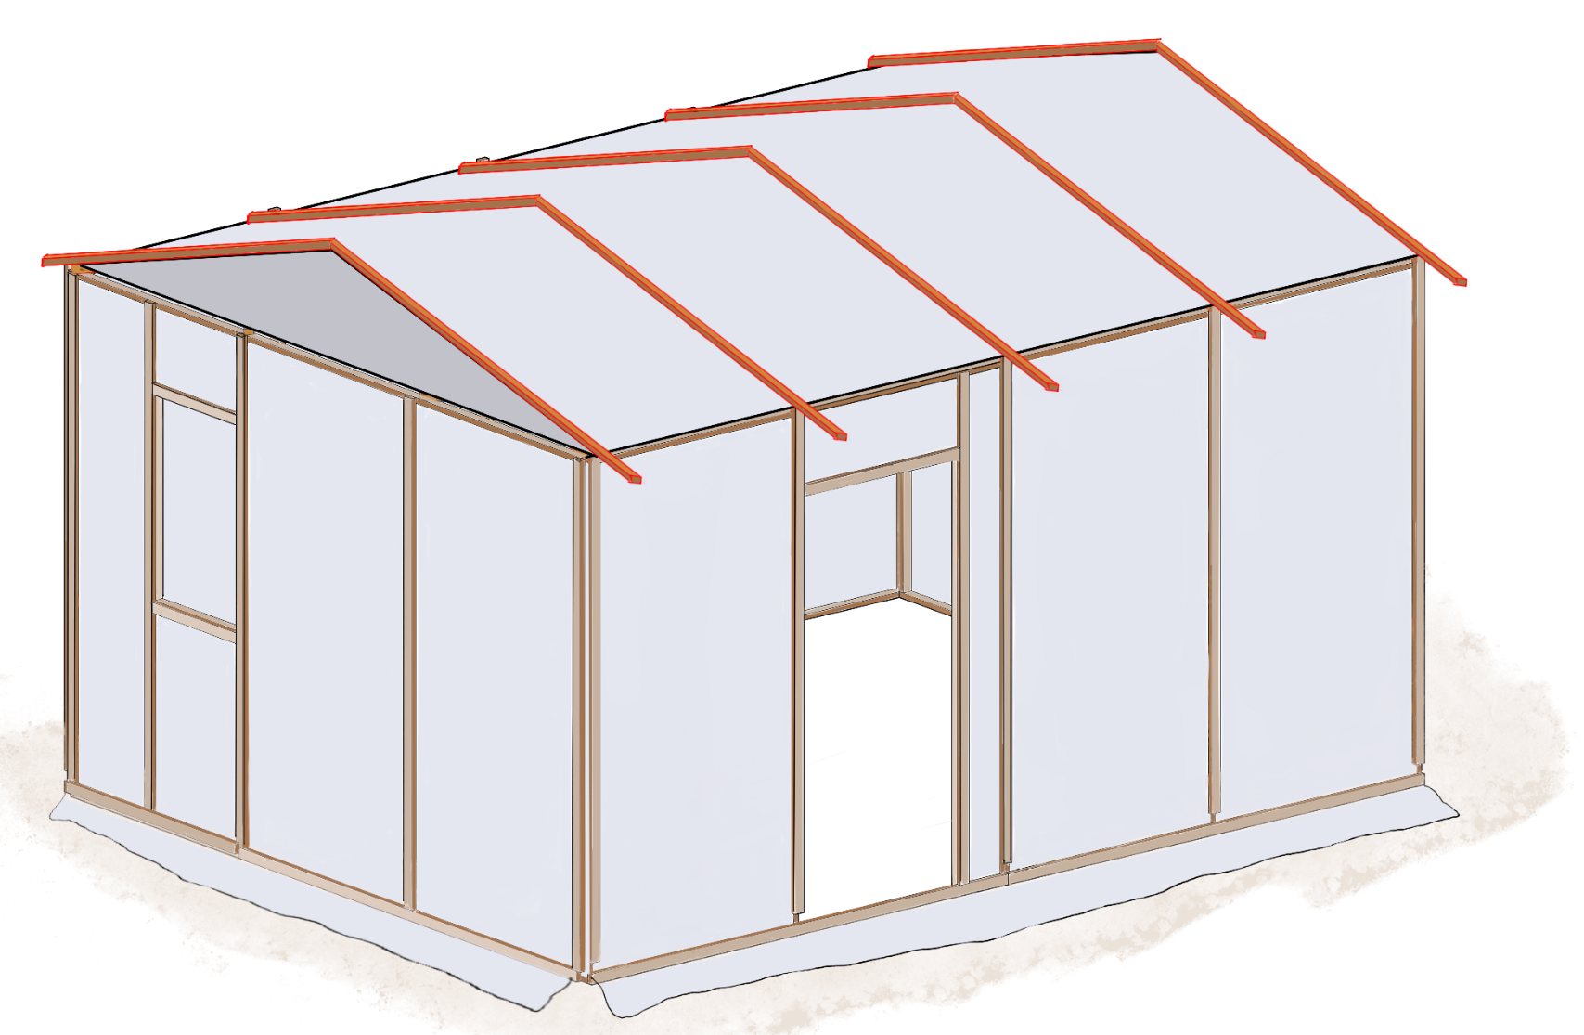
How to Cover the Roof
Fold the Tarpaulin to facilitate its raising to the roof
First fold: Fold the left-hand edge towards the centre line
Second fold: Fold again to the centre.
Repeat for the right-hand edge
Finally: Fold to the centre as shown.
2. Progressively unroll the tarpaulin over the roof structure - start from middle
3. Add timber cover battens and short off-cuts to pin roof tarp
30 cm
5cm nails
Cover batten
Truss
Tarp
The cover battens are there to secure the top of the tarpaulin.
Cover batten
Wall panel
Truss - Tarp - Timber wall connection
This IEC has been developed by

Slide 7
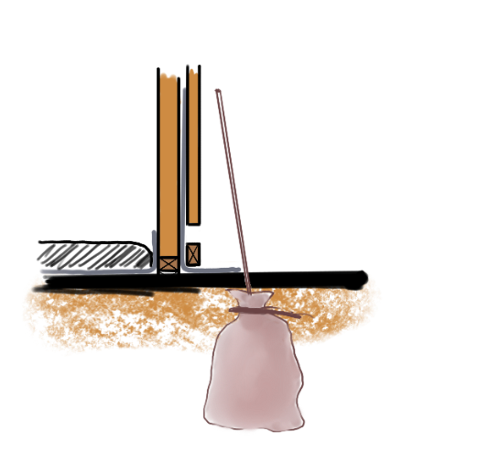
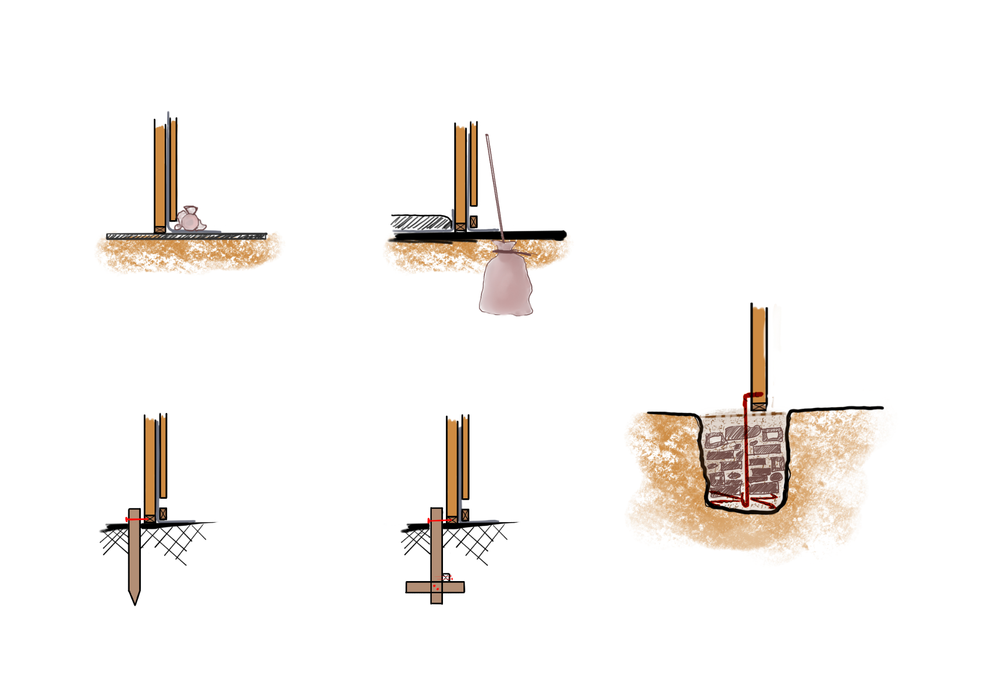
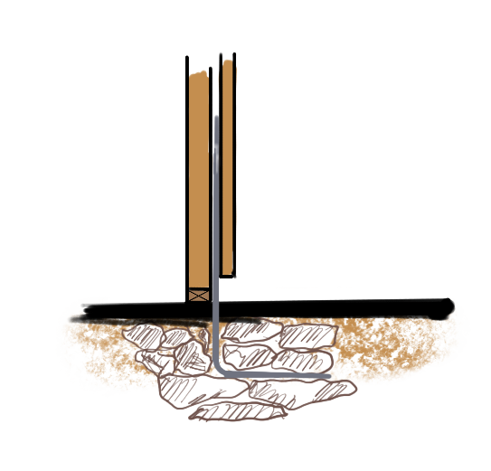
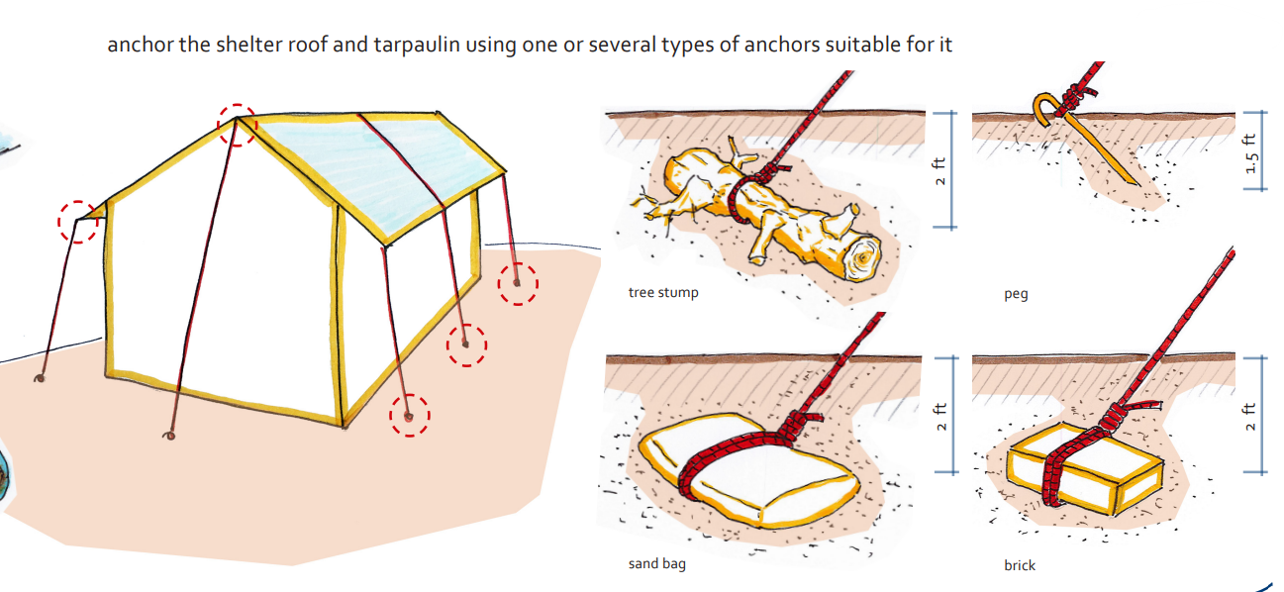
How to Fix Shelter on Ground
The type of anchoring, or foundation, will depend on the ground conditions.
A- SOFT/SANDY GROUND AND HARD SURFACE:
B- SOFT/SANDY GROUND:
Tarpaulin
Coverbatten
Rope
Tarpaulin
Coverbatten
INSIDE
OUTSIDE
Rocks, rubble sandbag
Concrete slab
Tarpaulin in ground
Rocks, rubble sandbag
INSIDE
OUTSIDE
Rocks and rubble
Weighing down the tarpaulin “skirt” is the simplest method and suitable for soft or sandy ground, and a concrete slab. Buried sandbags at each corner, or close to each corner, is another option for sandy ground
C- SOFT/SANDY GROUND:
Fill the hole with rubble, using larger pieces at the bottom.
Fill the voids with sand, dirt or soil.
Steel bar (10mm max)
Hooked at the bottom, bent
over the panel at the top
Steel mesh/bars
With rubble and old rebar available, this is an appropriate
anchoring or foundation detail.
Anchoring with sandbags can be replaced with:
D- FIRM GROUND:
Tarpaulin
Tarpaulin
Steel bar
Cover-batten
Cover-batten
INSIDE
OUTSIDE
INSIDE
OUTSIDE
60cm
Cross-brace
Brick/ hollow blocks/ or concrete
Driving, or burying, wooden stakes into the ground is only
suitable for firm ground.
In exposed areas, the use of guy-ropes is recommended
This IEC has been developed by

Slide 8
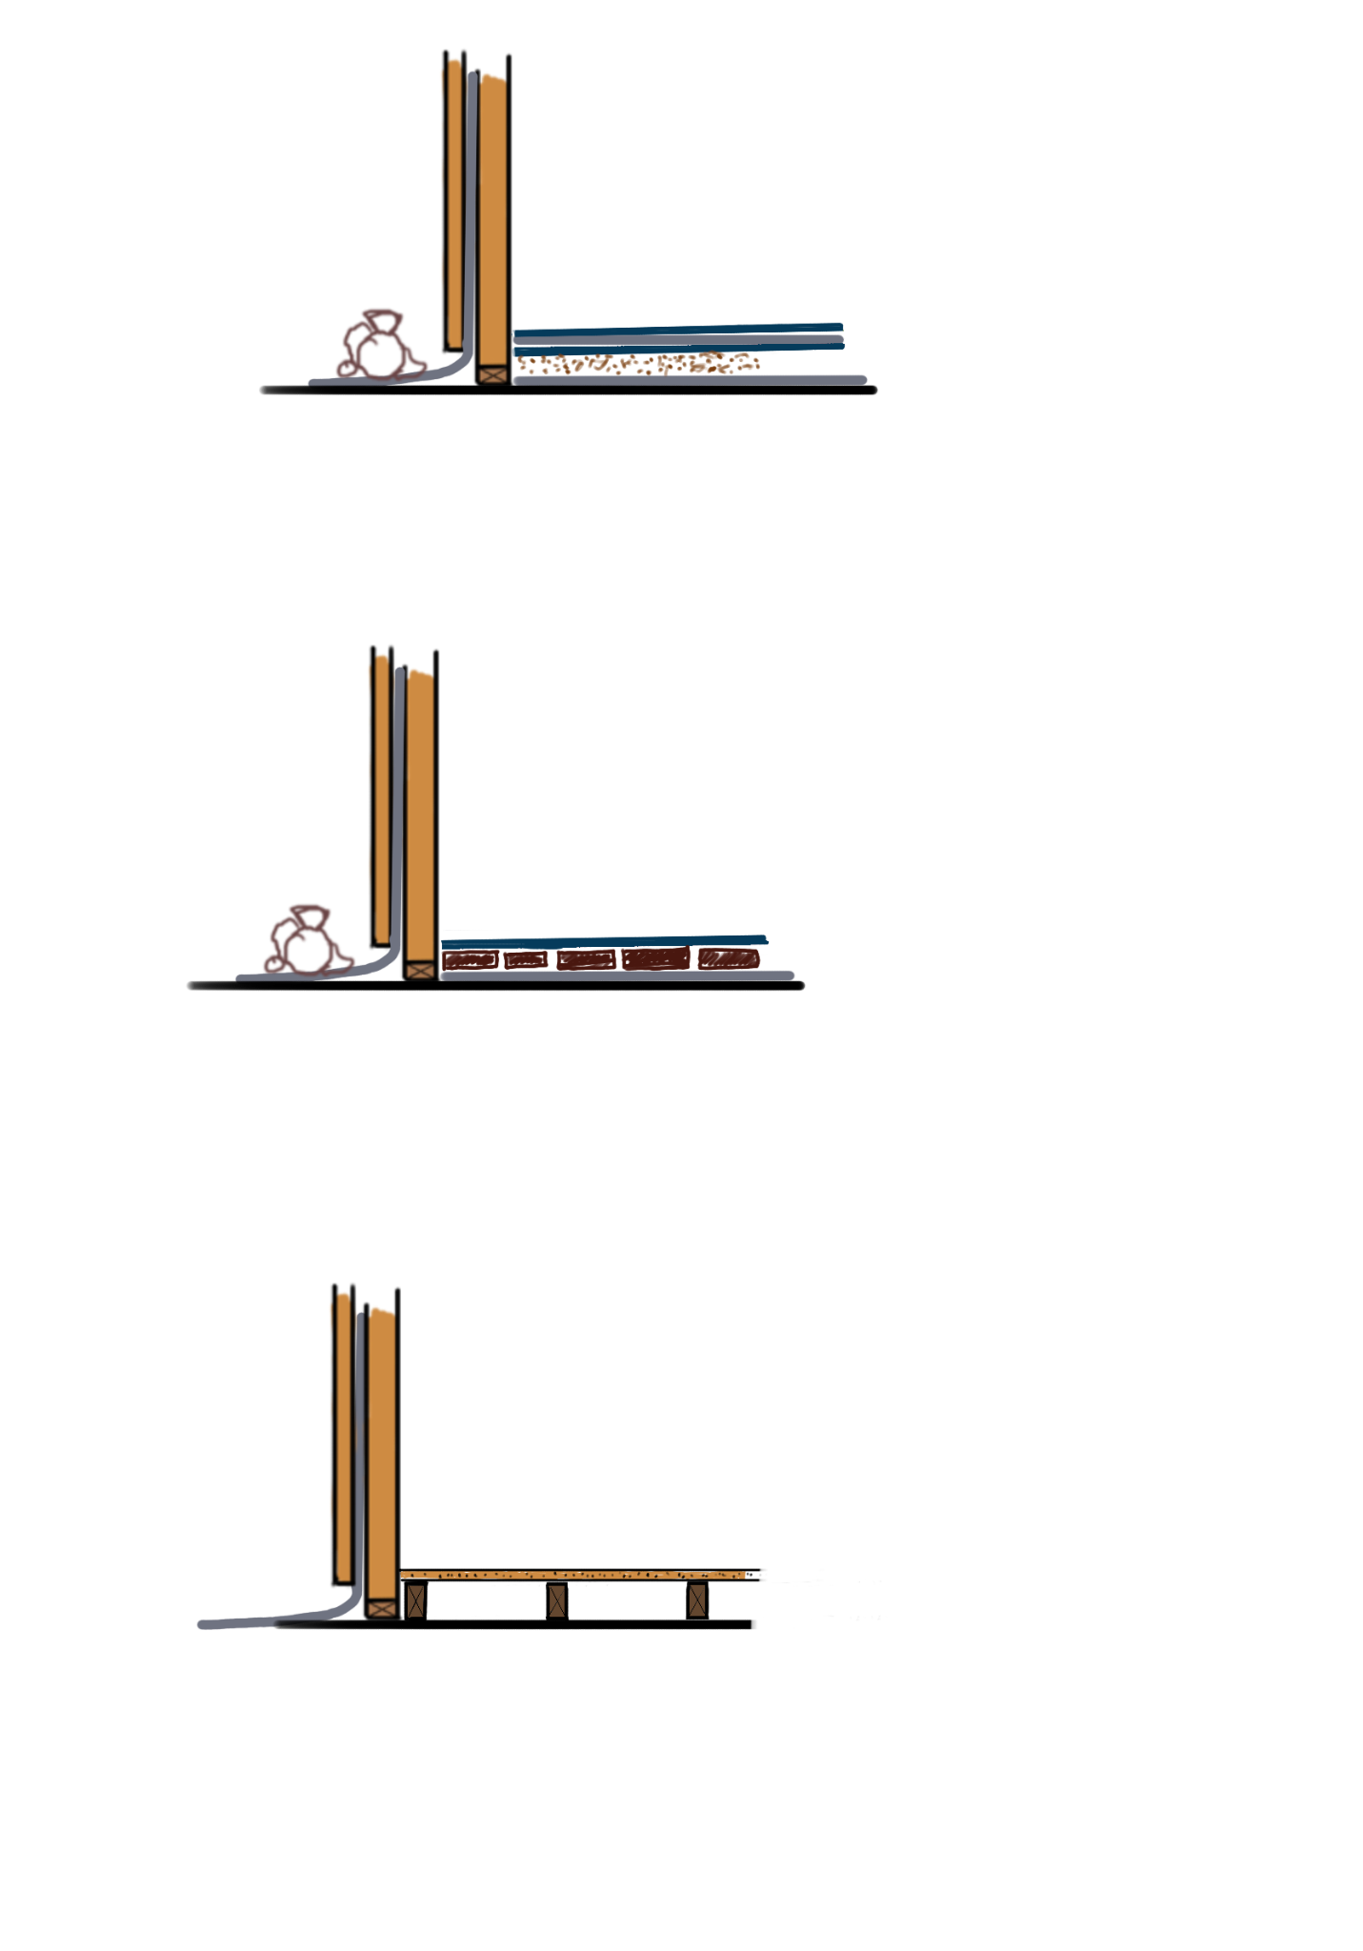

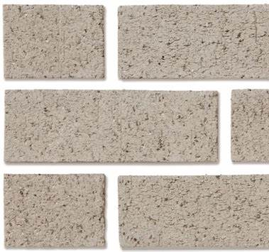
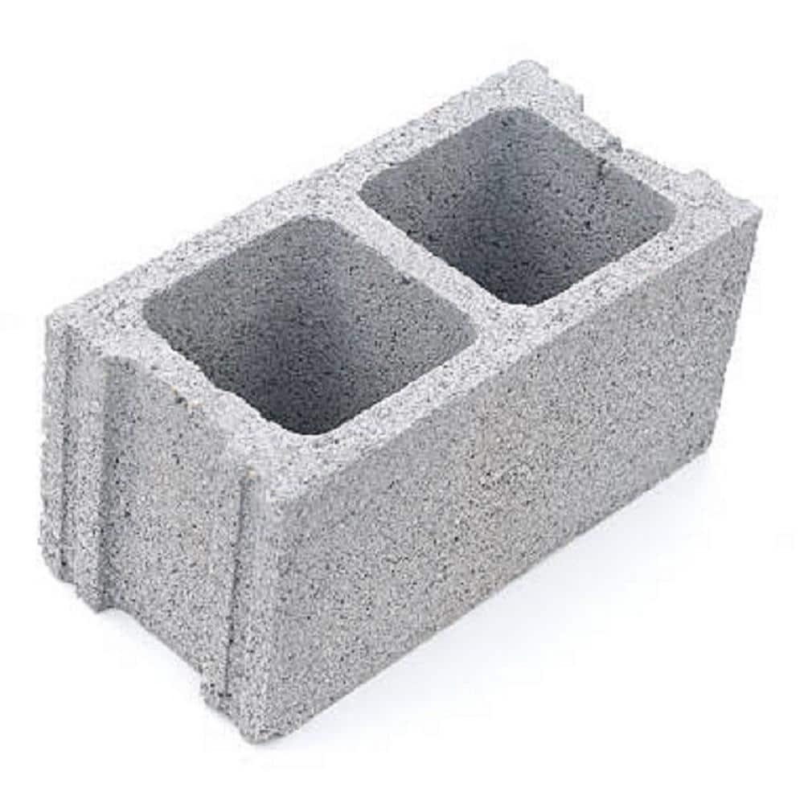
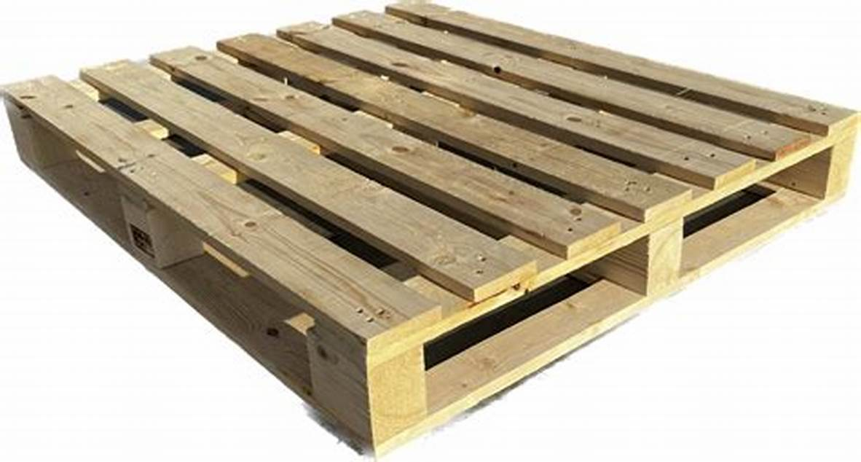
How to Cover the Shelter Floor
It is a good idea to have a raised floor inside the shelter that is kept dry and contained by a plastic sheet (a damp-proof membrane - DPM).
This can be achieved in a number of ways:
OUTSIDE
Floor Covering (Cardboard / Carpet, …)
Plastic Sheet (Optional)
Sand fill
Plastic Sheet as Damp Proof Membrane (DPM)
1. Simply covering the inside with plastic sheet, carpet or even cardboard.
OUTSIDE
Floor Covering (Cardboard / Carpet, …)
Brick / Block Paving
Plastic Sheet as Damp Proof Membrane (DPM)
2. Raising the ground level with rubble, bricks, broken blocks; filling the gaps with sand; and covering with a suitable flooring. A plastic sheet DPM is advised if available.
OUTSIDE
Floor deck(Timber, OSB)
Timber
Plastic Sheet as Damp Proof Membrane (DPM)
3. A good solution would be to use wooden pallets to construct a level raised floor.
This IEC has been developed by

